Slide 1

Student Registration System
Jared Kraus and Graydon Hall

Slide 2
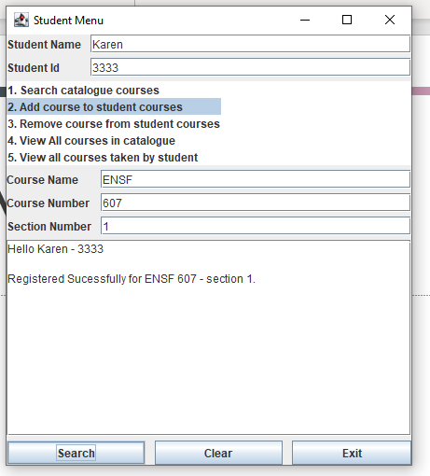
Front End Interface
Allows students to choose from the 5 specified options
Fields toggle on and off based on option selected

Slide 3
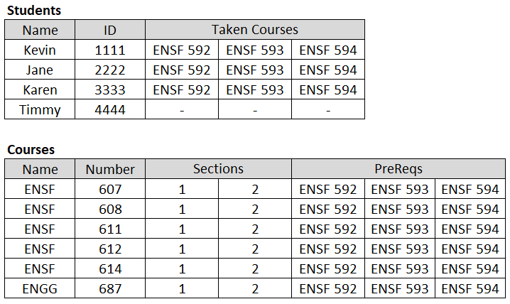
Database

Slide 4
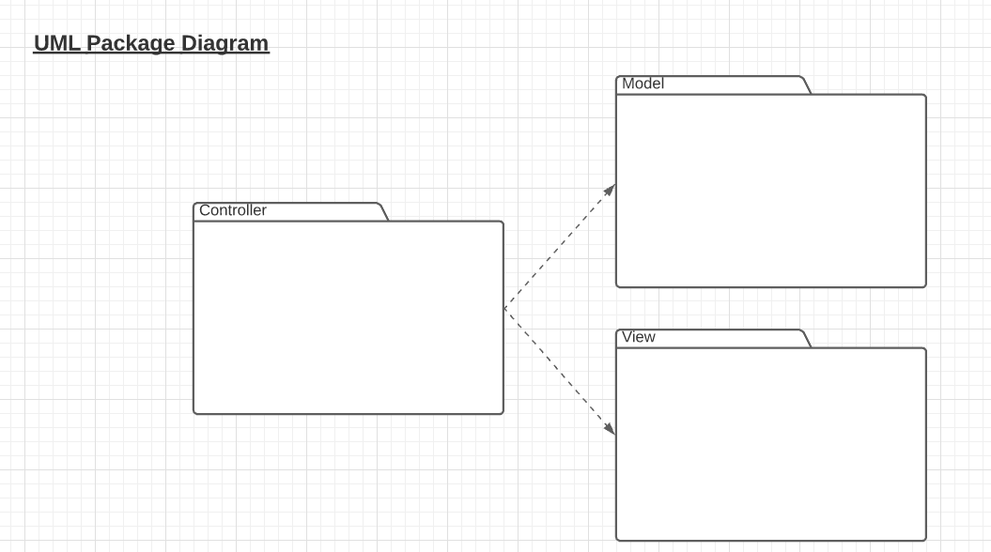
UML Package Diagram

Slide 5
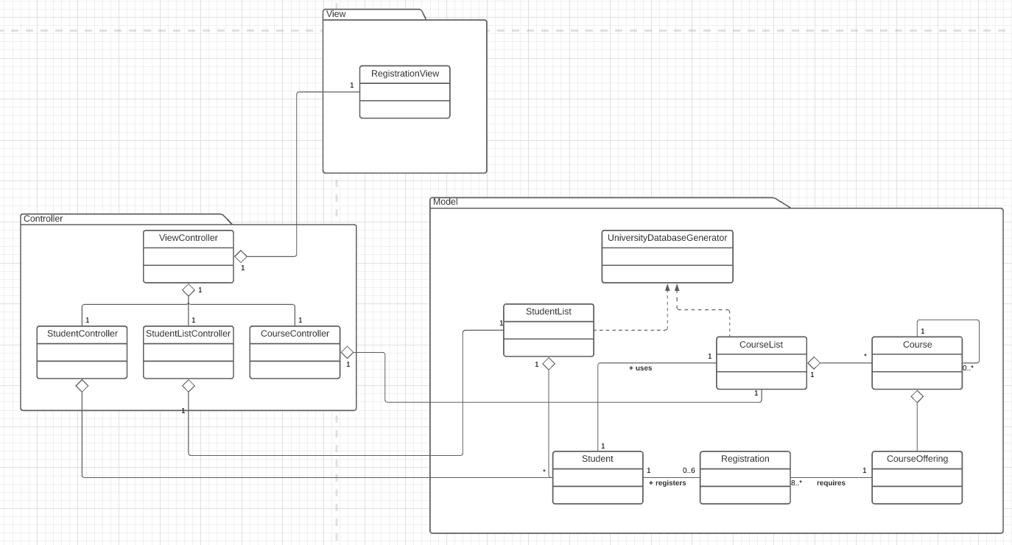
UML Class Diagram

Slide 6
Code overview

